Slide 1
Noninfectious Diseases

Slide 2
Noninfectious diseases are those that do not involve a pathological Agent. Noninfectious diseases include tumours (neoplasias) and developmental and physiological diseases. In addition, physical injuries and attacks by predators and pests will also be considered here. Environmental factors, notably adverse water conditions, which are a major underlying cause of noninfectious diseases, are also considered.

Slide 3
Noninfectious diseases can affect virtually any part of the fishs body, either external or internal, sometimes both. For example, various tumours have been associated with most organs and tissues in cyprinids.
In terms of injuries, such as arising from predator attack, it is typically the external surfaces of the fish that incur the majority of the damage.

Slide 4
Sometimes, a noninfectious disease or injury can predispose the fish to an infectious disease, an example being damage to the skin epithelium as a result of rough handling which can lead to invasion by opportunistic pathogens such as Oomycetes (fungi).

Slide 5
a-Developmental and physiological disease
Developmental abnormalities have been recorded in all fish groups . Some developmental problems are due to genetic factors, whilst others have been linked with adverse environmental conditions, including the presence of pollutants.

Slide 6
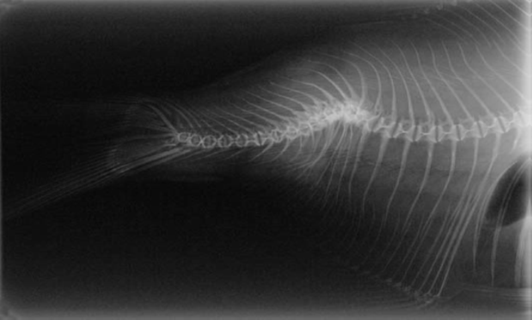
Deformities of the head, eyes, gills, and in particular the skeletal system are most commonly reported, due to their obvious manifestations (Fig.·6.5). It appears likely that developmental deformities are responsible for many deaths during the early life history of fish, both in nature and under captive conditions. However, in some cases aquaculture may actually contribute to the incidence of deformities within captive fish stocks, with factors such as unsuitable larval diets, adverse water chemistry, and adverse water temperatures being blamed.
Fig.·6.5–X-Ray photograph of a common bream with a severe deformity of the posterior section of its backbone .

Slide 7
Some of the intensive aquaculture practices which are applied to enhance production have been shown to cause deformities in a range of fish species, Example include the use of hormones to induce spawning of broodstock and for promoting larval growth, and the use of manure and other fertilisers in pond culture.
As far as wild fish are concerned, it is increasingly recognised that the contamination of freshwaters by various industrial pollutants is causing developmental abnormalities in these stocks.

Slide 8
Common disease problems
Certain noninfectious disease problems are relatively common, e.g. swimbladder disorders and noninfectious dropsy.

Slide 9
Swimbladder disorders
In fish , the swim bladder is typically large and comprises two chambers that connect via a narrow duct. Dysfunction of the swim bladder may cause the fish to float at the surface or sink to the substrate, as a result of over-inflation or collapse of the swimbladder, respectively.
Swim bladder inflammation disease has been recorded in several fish species, and appears also to be related to transportation stress. In addition, certain microbial and parasitic diseases can also cause swim bladder damage, and differentiating between infectious and noninfectious causes can be difficult.

Slide 10
Noninfectious dropsy
As with swimbladder disorders, dropsy can also arise from one of several causes. Apart from infectious diseases, dropsy may result from physiological disorders of the osmoregulatory system or by tumours or injuries associated with one or more organs of osmoregulation.
Senile induced osmoregulatory dysfunction is a further possible cause of dropsy, which is sometimes seen in captive fish. Fish suffering from dropsy have a distended belly, due to the accumulation of ascites fluid and muscle water content, which causes the scales to raise so as to give the characteristic serrated contour to the body. In some cases, dropsy may coincide with exophthalmia. .

Slide 11
b-Environmentally induced diseases
Most environmentally induced diseases are directly caused by adverse water conditions. Fish do not live in chemically pure water, for all natural water bodies contain numerous other substances which are present in either a dissolved or suspended state.
Fish have adapted to live within a relatively narrow range of water parameters which can be defined in terms of temperature, pH, dissolved oxygen level, hardness, and other physico-chemical properties.

Slide 12
There are considerable variations between species in their tolerance range to these various water parameters, to the extent that a given set of water conditions may be optimal for one species but physiologically stressful to another.

Slide 13
1-WATER TEMPERATURE
Fish are ectothermic animals, which means that they do not generate body heat and their body temperature is thus dependent on the surrounding environmental temperature. Water temperature therefore has a profound influence on fish, affecting their rate of metabolism and other biological processes.
Fish will suffer if exposed to water temperatures outside of their physiological tolerance range. An extreme of temperature may not necessarily be lethal, but can have long-term effects on the fishs health status. Diseases and abnormal behaviours are associated with exposure to extreme high or low temperatures for the species.

Slide 14
High temperatures
Fish that are exposed to high temperatures may suffer :-
1-respiratory stress and nervous activity. This is because increasing water temperature exerts a dual effect on the fish’s oxygen demand/supply ratio. The warmer water carries less dissolved oxygen, yet it increases the fish’s requirement for this gas due its increased metabolic rate.
2- High water temperatures can also affect the fish’s ability to osmoregulate, by altering the lipids within the fish’s gill cells, making the cells leaky and less efficient at regulating salt balance and excretion.

Slide 15
3-Increasing water temperatures also have an indirect effect on the fish’s health by increasing the toxicity of certain pollutants, such as heavy metals.
4- High temperature also has a thermal effect on nitrogenous wastes, by increasing the proportion of ammonia that is present as the toxic nonionised form.
Anthropogenic activity also increases water temperature, e.g. discharge from industries.

Slide 16
Low temperatures
Fish health problems can occur as a result of low water temperatures:-
1- In the case of temperate fish , the fish’s immune system may be compromised at cold temperatures, rendering the fish more prone to infections caused by fungi and certain bacteria.

Slide 17
2- Respiratory stress and coma. Even though cold water contains more dissolved oxygen than warm water, its suppressive effects on the fish’s respiratory rate and heart rate means that fish may become hypoxic at very low temperatures due to insufficient oxygen uptake.
3-Behavioural signs associated with hypothermia include lowered respiratory rate and loss of swimming co- ordination.

